Slide 1


SAP UI5 & FIORI with OData TRAINING using BAS
Anubhav Oberoy
Day – 2

Slide 2

Agenda – Day 2
Block Level Elements
Ordered and Unordered List in HTML
Multimedia Tags in HTML (audio, video and Iframe)
Tables in HTML
Introduction to CSS
Inline style CSS
Internal style CSS
Concept of Box Model in CSS
Concept of Pseudo Classes in CSS
External style CSS

Slide 3
Block Level and Inline Elements in HTML
Block Level Elements
A block-level element always starts on a new line.
A block-level element always takes up the full width available (stretches out to the left and right as far as it can).
A block level element has a top and a bottom margin, whereas an inline element does not.
The <div> element is a block-level element.
div – division tag – it is used to divide screen in multiple group of elements. Every div element always starts with new line.
Here are the some block-level elements in HTML:
<p> <div> <li> <hr> <video> <h1> to <h6> etc.,
Inline Elements
An inline element does not start on a new line.
An inline element only takes up as much width as necessary.
This is a <span> element inside a paragraph.
Here are the inline elements in HTML:
<a> <input> <button> <span> <textarea> etc.,
Block Level Elements
Element 1
Element 2
Element 3
Element 4
Inline Elements
Element 1
Element 2
Element 3
Element 4

Slide 4
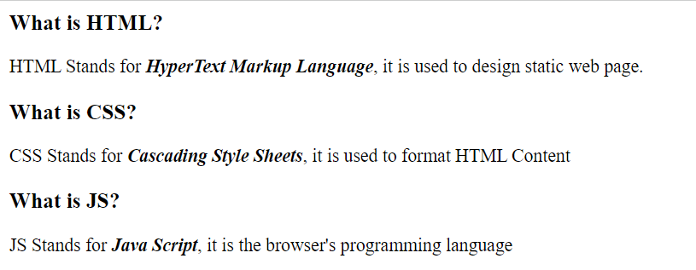
Hands – on: Block Level Elements
Now we will put the Heading and the definition of HTML, CSS and JS in different <div> tags, to demonstrate the block of content.
Code Link:
index.html

Slide 5
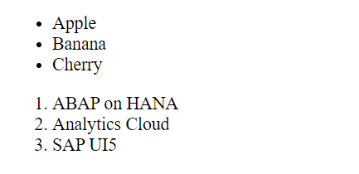
Ordered and Unordered List
HTML lists allow web developers to group a set of related items in lists.
Unordered HTML List:
An unordered list starts with the <ul> tag. Each list item starts with the <li> tag.
The list items will be marked with bullets (small black circles) by default.
Ordered HTML List:
An ordered list starts with the <ol> tag. Each list item starts with the <li> tag.
The list items will be marked with numbers by default.
An unordered HTML list:
Item
Item
Item
Item
An ordered HTML list:
First item
Second item
Third item
Fourth item
Hands – on: Ordered and Unordered List
Now we will create the ordered and unordered list in our web page using the <ul>, <ol> and <li> tags.
Code Link:
index.html

Slide 6
Introduction to Multimedia Tags in HTML
Multimedia on the web is sound, music, videos, movies, and animations.
Audio
The <audio> tag is used to embed sound content in a document, such as music or other audio streams.
The controls attribute adds video controls, like play, pause, and volume.
Video
The <video> tag is used to embed video content in a document, such as a movie clip or other video streams.
The controls attribute adds video controls, like play, pause, and volume.
Iframe
The <iframe> tag specifies an inline frame.
This is the easiest way to embed videos in HTML.
An inline frame is used to embed another document within the current HTML document.
We can also use <iframe> element to add YouTube videos in our web page.

Slide 7

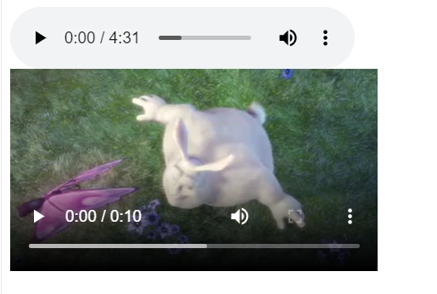
Hands – on: Multimedia Tags in HTML
Add the Multimedia elements to our web page using the audio, video and iframe tag.
Code Link:
index.html

Slide 8
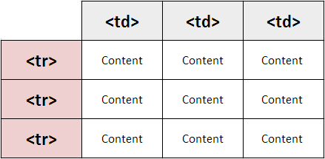
Introduction to Table element in HTML
HTML tables allow web developers to arrange data into rows and columns.
A table in HTML consists of table cells inside rows and columns
The <table> tag defines an HTML table.
An HTML table consists of one <table> element and one or more <tr>, <th>, and <td> elements.
The <tr> element defines a table row, the <th> element defines a table header, and the <td> element defines a table cell.
By default, the text in <th> elements are bold and centered, but you can change that with CSS.

Slide 9
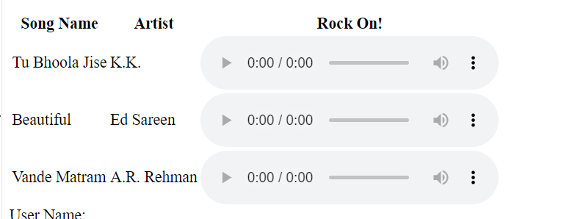
Hands – on: Table using HTML
Create a table in our HTML page using the <table> element and embed the audio tags in that table.
Code Links:
index.html

Slide 10

Introduction to CSS
CSS Stands for Cascading Style Sheets, it is used to format/beautify the HTML content.
CSS describes how HTML elements are to be displayed on screen.
CSS saves a lot of work. It can control the layout of multiple web pages all at once.
We need CSS because HTML can only generate static content w/o coloring, formatting, borders, beautification.
Before css we have to use HTML tags for formatting which was very cumbersome
<p>I <b><color value=“red”>love</color></b><font val=“Calibri”>India<font></p>
There are 3 ways we can apply CSS on HTML Content
Inline CSS – applied at each element level <tagname style=“prop:val;prop:val;..”>….
Internal CSS – applied at the page level to target one or more than one html elements on the page. It is fully reusable.
External CSS – Where the CSS is applied by putting code in a reusable css file and later use the link tag to connect the same.

Slide 11
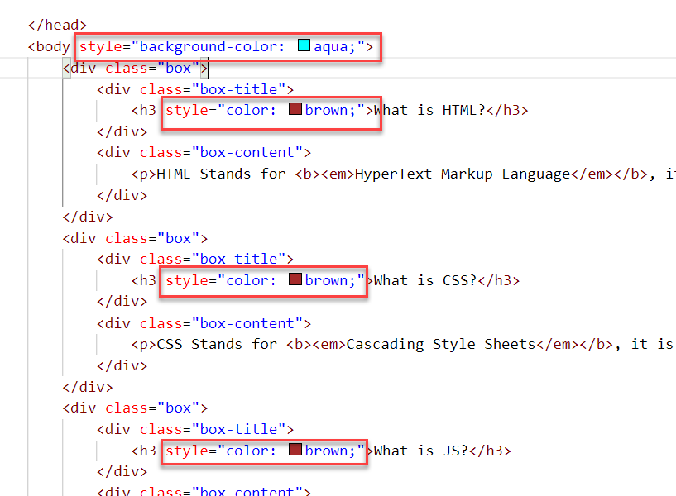
Inline CSS
Inline CSS is used to style a specific HTML element.
To apply Inline CSS add a style attribute to each HTML tag.
Inline styles in CSS could be useful for previewing changes instantly.
It can be useful when adding CSS rules to only one or two elements.
Syntax to apply Inline style CSS
<htmltag style="cssproperty1:value; cssproperty2:value;"> </htmltag>
We can see all the available CSS properties on the W3C:
https://www.w3schools.com/css/default.asp
Disadvantages of using Inline style CSS:
These styles cannot be reused anywhere else.
Adding CSS using this technique is time-consuming.
These styles are tough to be edited because they are not stored at a single place.

Slide 12
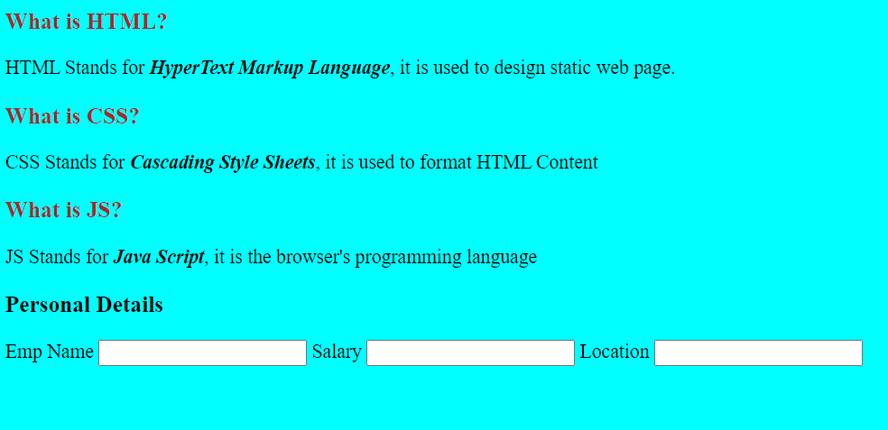
Hands – on: Inline CSS
Apply basic style to our html page using the Inline CSS technique.
For this exercise we will create a new file named cssbasics.html in our current folder.
Code Link:
cssbasics.html

Slide 13
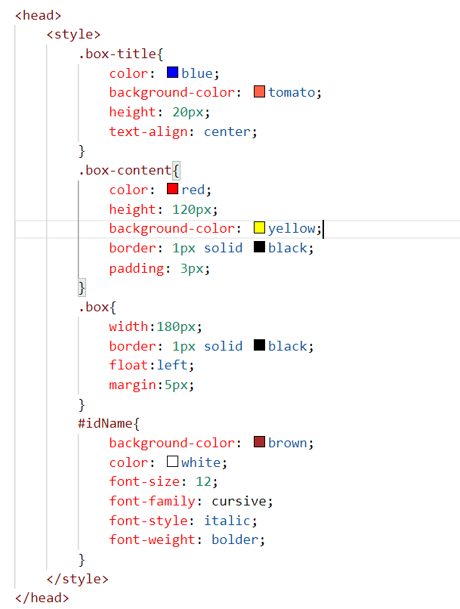
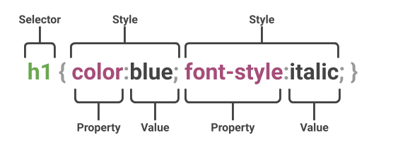
Internal CSS
The internal style sheet is used to add a unique style for a single document. It is defined in <head> section of the HTML page inside the <style> tag.
This CSS style is an effective way to style single pages.
Internal CSS is applied using the Selectors in the HTML page, which makes the styling easy.
Syntax to apply the Internal style CSS
<style>
selector{
propertyname: value;
propertyname: value;
}
</style>
Selector: CSS selectors are used to "find" (or select) the HTML elements you want to style.
The are three type of selectors in CSS.
#id: Id of the single element
.classname: group of elements which has same classification property
Tagname: group of elements which has same tag name

Slide 14
Box Model in CSS
In CSS, the term "box model" is used when talking about design and layout.
All HTML elements can be considered as boxes.
The CSS box model is essentially a box that wraps around every HTML element. It consists of: margins, borders, padding, and the actual content. The image below illustrates the box model:
margin
border
border
padding
Html element
Html element

Slide 15
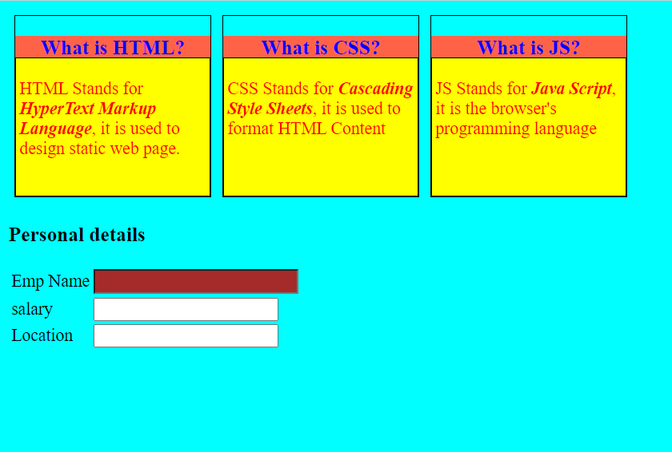
Hands – on: Internal CSS
Now will apply the CSS using the Internal style CSS to our block level elements (box and box-content), will also see how to use different types of selectors for styling the content.
We will also see some commonly used properties of CSS.
Code Links:
cssbasics.html

Slide 16
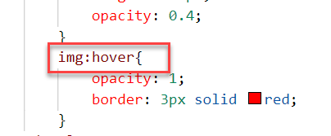

Pseudo-classes in CSS
A pseudo class is used to apply effects on the control based on special conditions or activity.
For example, it can be used to:
Style an element when a user mouses over it
Style visited and unvisited links differently
Style an element when it gets focus
Syntax to use pseudo class
selector:pseudo-class { property: value; }

Slide 17
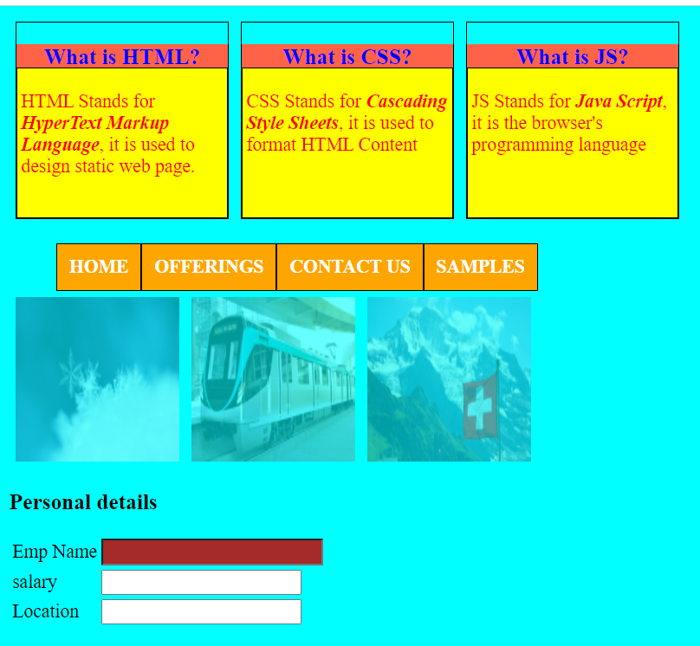
Hands – on: Pseudo Classes in CSS
Add three images and style them using the hover class of CSS. So when we hover the mouse on the image gets highlighted.
Also create a Navbar in our HTML Page.
In this exercise we will also see how to apply styling on the child elements using the parent element..
Code Links:
cssbasics.html

Slide 18
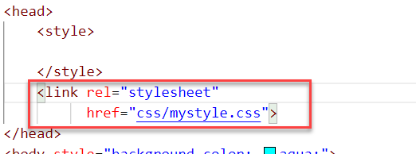
External CSS
In external CSS, we link the web pages to the external .css file.
This CSS type is a more efficient method, especially for styling a large website. By editing one .css file, you can change your entire site at once.
Since the CSS code is in a separate document, your HTML files will have a cleaner structure and are smaller in size.
An external style sheet can be linked to an HTML document using the <link> tag. The <link> tag goes inside the <head> section.

Slide 19
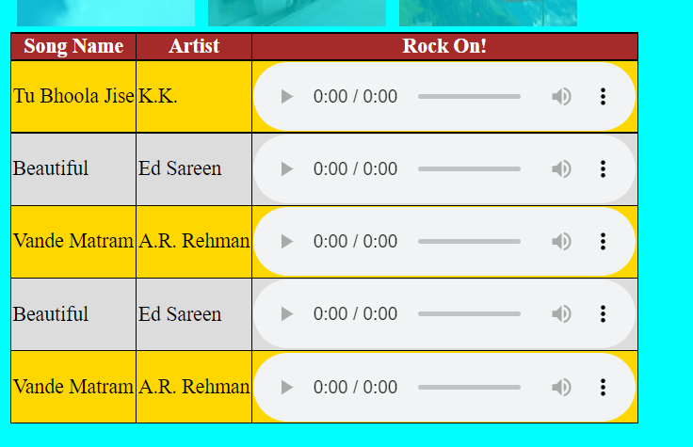
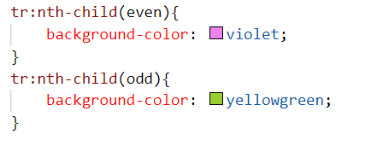
Hands – on: External CSS
Now we will use the External style CSS to style our HTML page.
We will also style our table element to demonstrate the concept of styling the child elements.
Exercise code:
cssbasics.html
mystyle.css

Slide 20

End of Day 2

Slide 21

Questions

Slide 22

Anubhav Oberoy

Slide 23


We’re committed to empower you to be
Most Desirable Resource
through powerful training solutions.
We build the workforce of the future.
250+
Corporate Clients
30,000+
Learners Trained
25000+
Learners Placed
FREE WEBINARS
Sign up for free webinars with industry experts every fortnight!
Enroll Now!
Contact us today!
https://anubhavtrainings.com/

Slide 24




More from AnubhavTrainings.com

Slide 25
Title
Content

